Slide 1
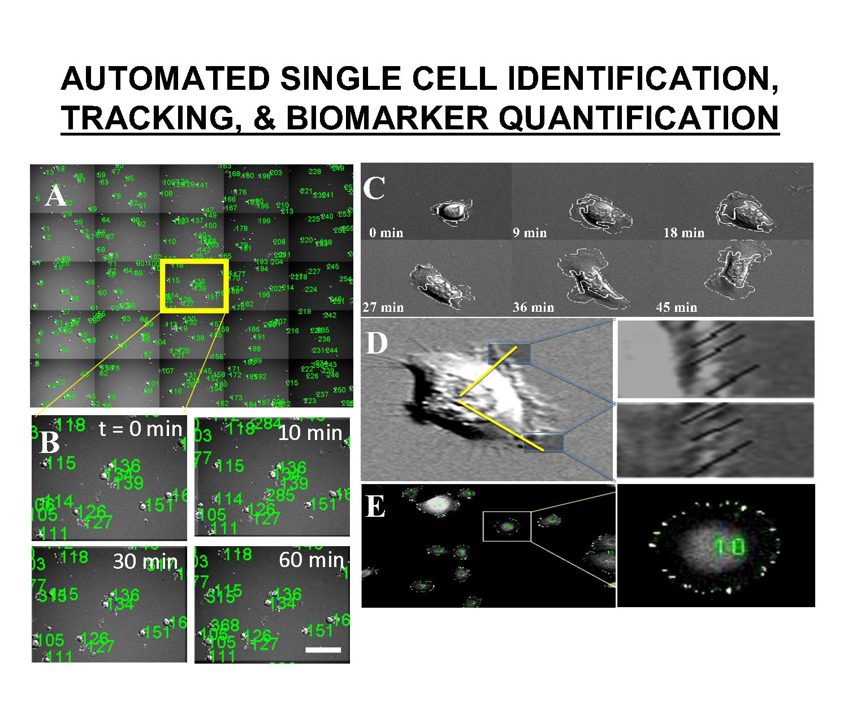
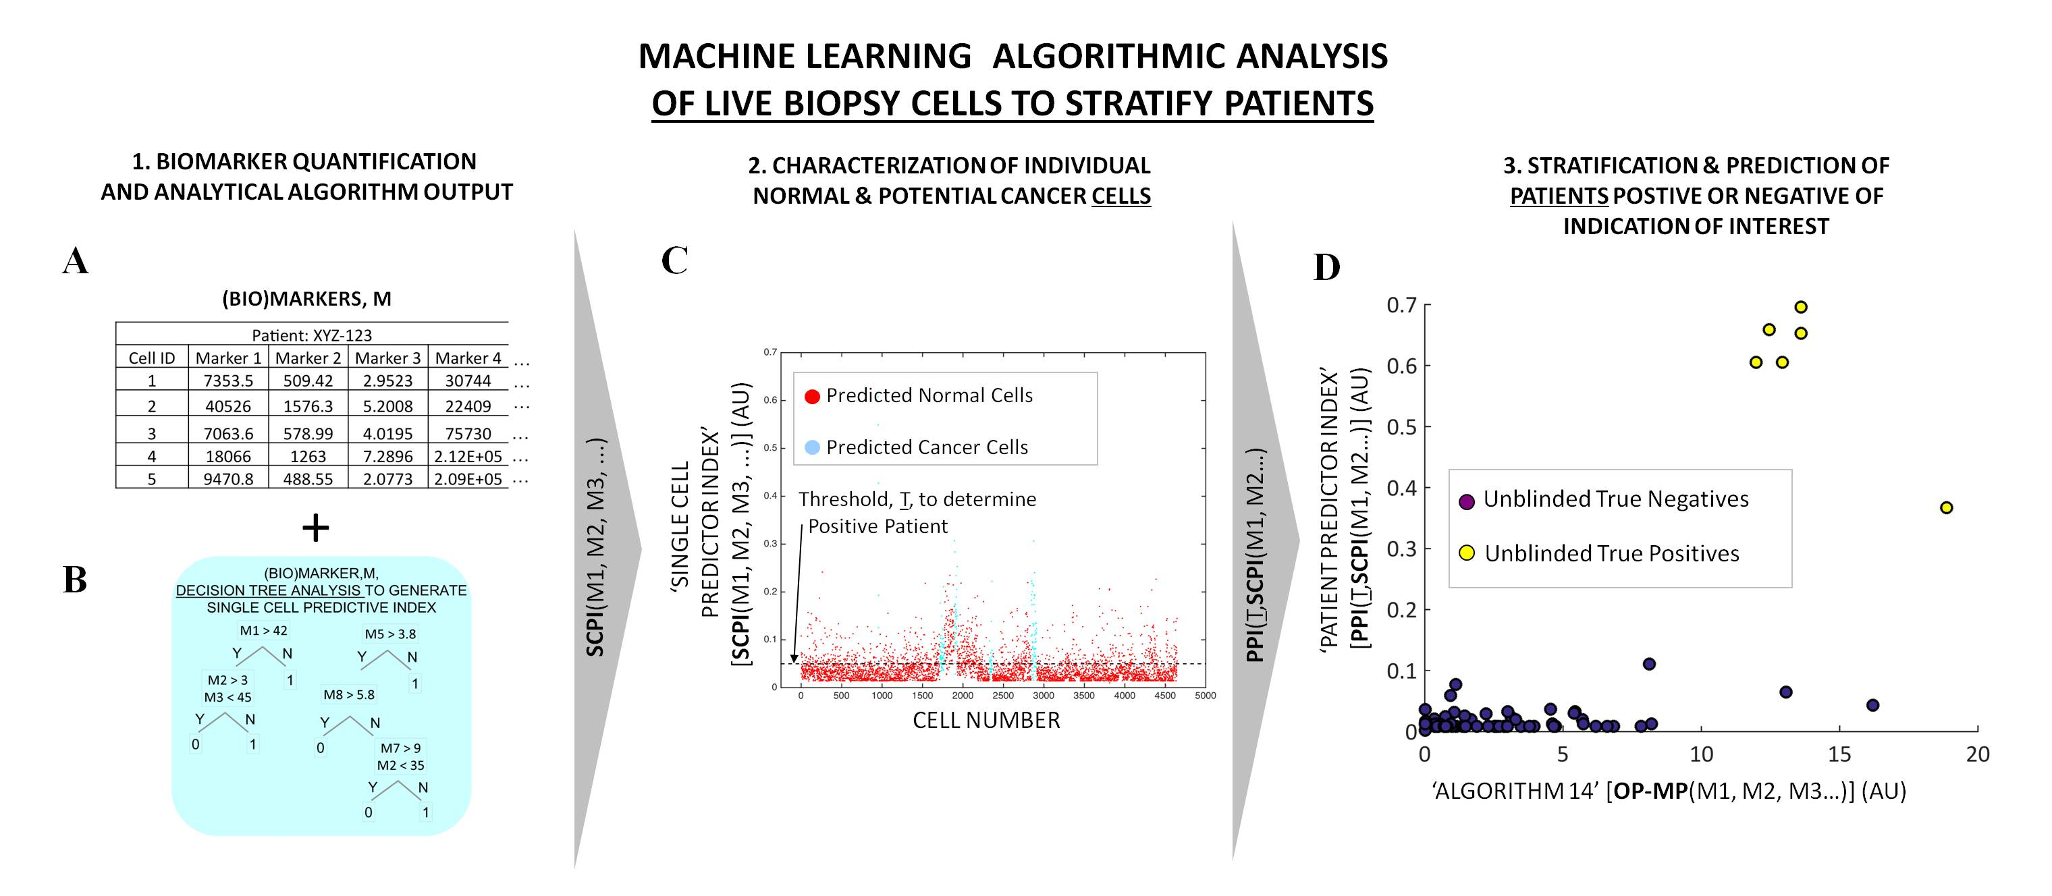
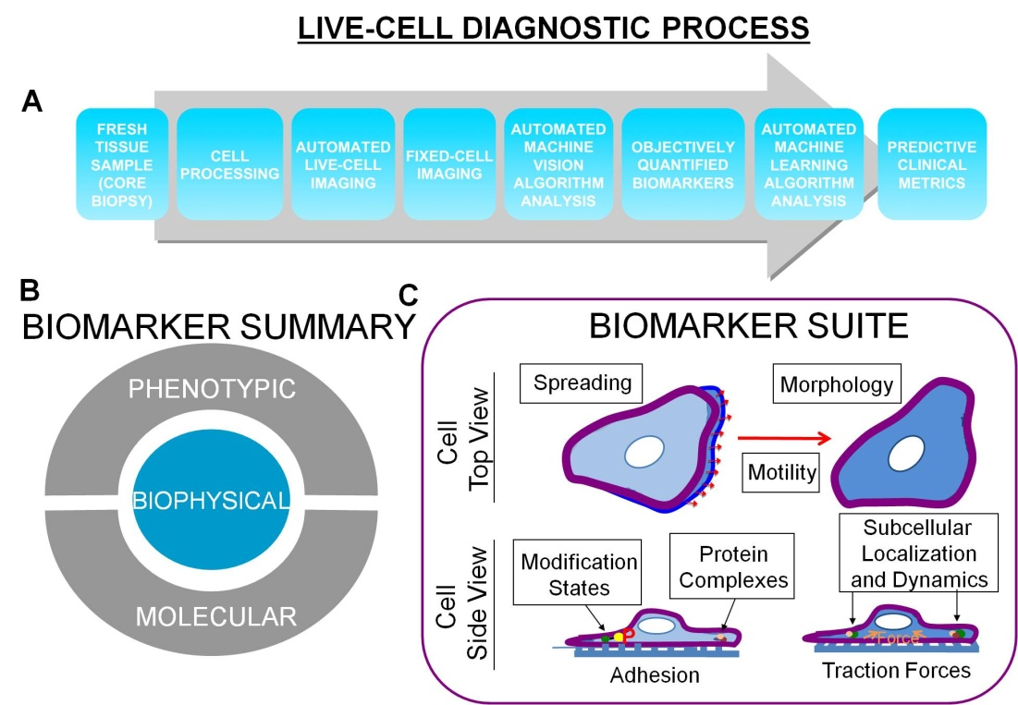
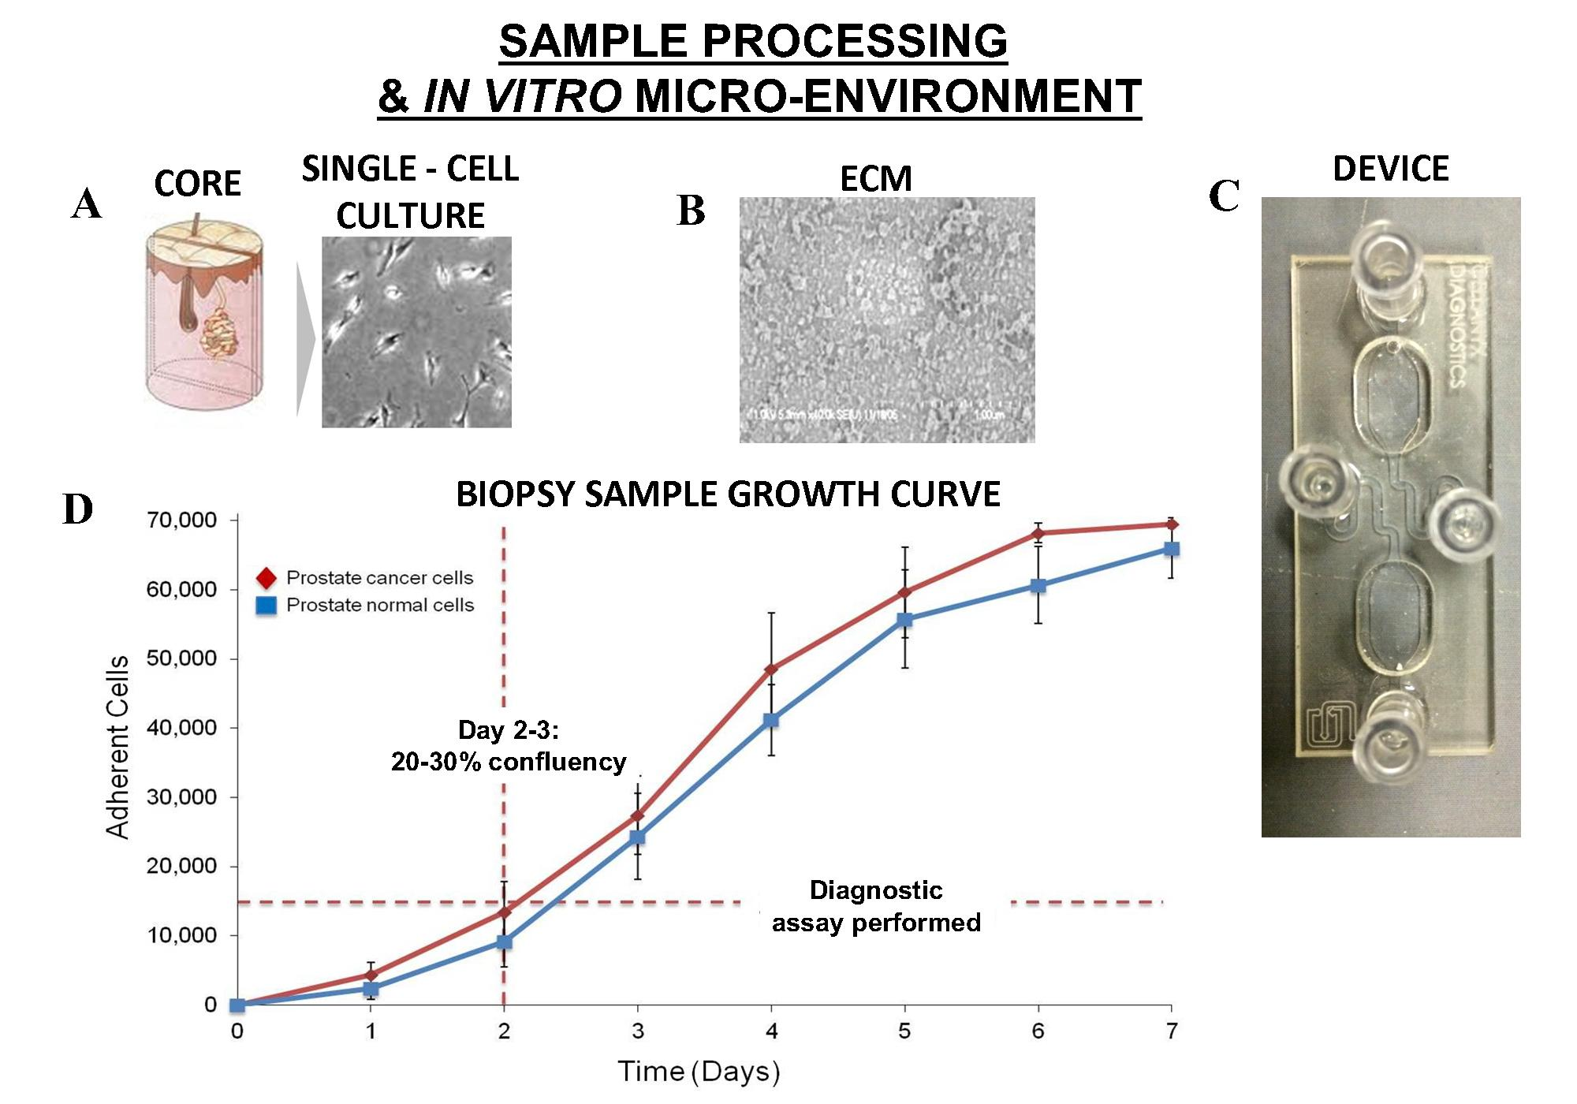
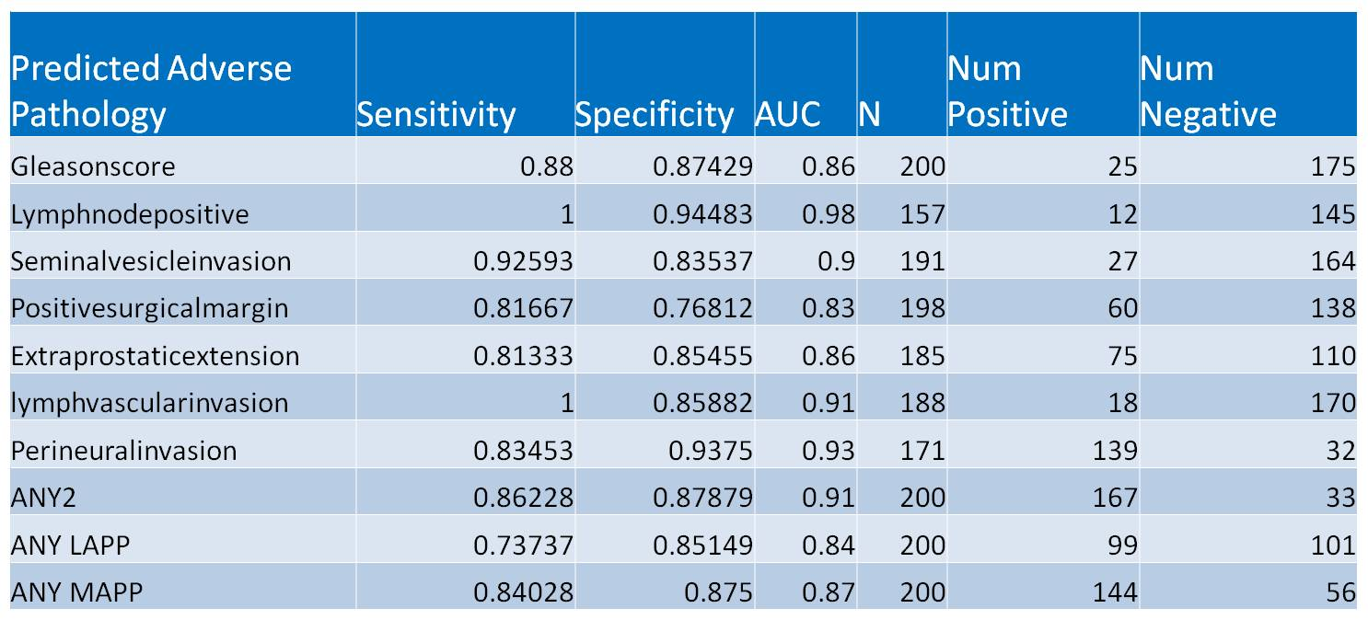
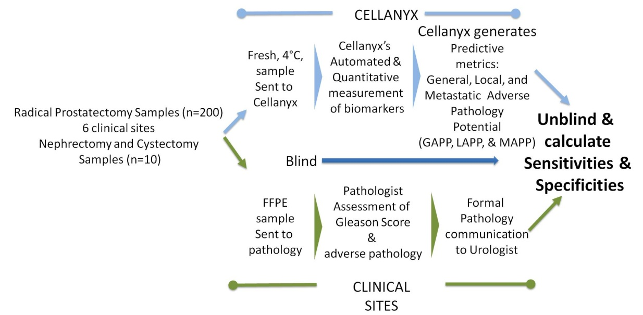
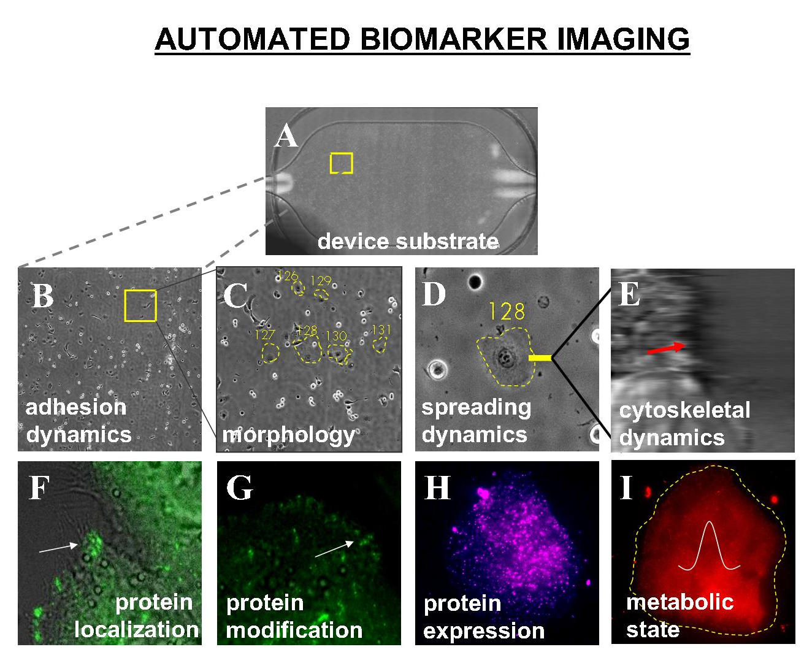
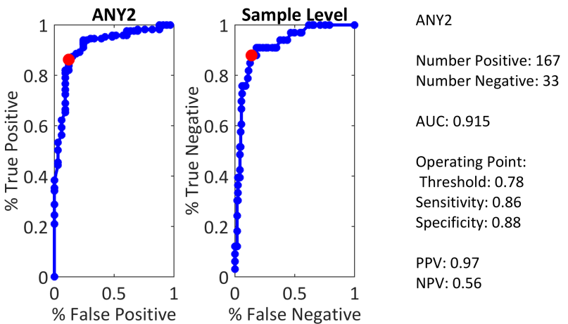
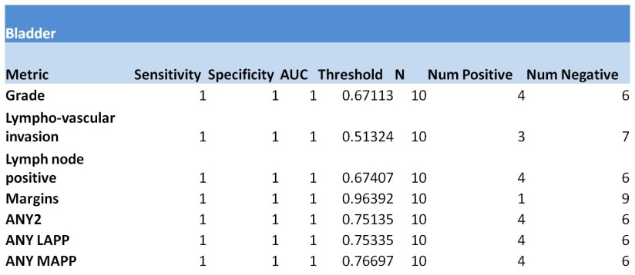
A Live Cell Microfluidics Device Utilizing Phenotypic Biomarkers for Prostate Cancer.
David Albala MD¹, Vladimir Mouraviev MD², Kimberly Rieger−Christ PhD³, Travis Sullivan MS³, Naveen Kella MD⁴, Kevin Knopf MD⁵, Hani Rashid MD⁶, Michael Manak PhD⁷, Brad Hogan PhD⁷, Gauri Dixit PhD⁷, Delaney Berger BA⁷, Wendell Su MS⁷, Matthew Whitfield PhD⁷, Jonathan Varsanik PhD⁷, Mani Foroohar MD⁷, Ashok Chander PhD⁷ and Grannum Sant MD⁸
¹Associated Medical Professionals of New York; ²Florida Hospital, Orlando, FL; ³Lahey Hospital and Medical Center, Burlington, MA; ⁴The Urology Place, San Antonio, TX; ⁵California Pacific Medical Center, San Francisco, CA; ⁶University of Rochester Medical Center School of Medicine and Dentistry, Rochester, NY; ⁷Cellanyx Diagnostics, Beverly, MA; ⁸Tufts University School of Medicine, Boston, MA
Introduction: A novel tissue based biomarker panel is introduced to objectively assess disease aggressiveness and invasive potential of Prostate Cancer (CaP). The biomarker diagnostic platform incorporates both molecular and phenotypic data that may allow an improved understanding of local growth and metastatic potential. The tissue based diagnostic incorporates matrix biology, phenotypic biomarkers, microfluidics, and machine vision. This technology presents the opportunity to culture samples, and both determine and automate biomarker measurements from machine vision algorithm analysis. Data are presented towards clinical validation, the ability to risk stratify, and prediction of local aggressiveness and metastasis.
Methods: Conditions were optimized for reliably culturing primary cancer cells in vitro by simulating in vivo conditions on an extracellular matrix formulation. A microfluidics device was used to culture live tumor samples ex vivo enabling automated imaging of the label free and label-based biomarkers.
Results: The validation study was IRB approved and performed in 200 consecutive CaP radical prostatectomy derived specimens collected between 03/2014 and 09/2015. Data was analyzed with receiver operating characteristics (ROC) generated Area-under-the-Curve (AUC) and specifically included capsular penetration, seminal vesicle invasion, as well as margin-positive disease. AUC Graphs are presented. The study further demonstrated that a normal set of phenotypic biomarkers can produce secondary metrics termed General Adverse Pathology Potential (GAPP), Local Adverse Pathology Potential (LAPP), & Metastatic Adverse Pathology Potential (MAPP) . Concordance analysis supports that LAPP and MAPP are integral for distinguishing between benign histology and malignancy, predicting both stage and adverse pathology such as extra-prostatic extension (EPE) and lympho-vascular invasion (LVI). The study results demonstrate AUCs greater than 0.85 in predicting EPE and LVI.
Conclusion: Results support the clinical validation of a novel live- cell phenotypic in vitro tumor diagnostic test. This test has the potential to predict adverse pathologies for CaP and may have extended clinical applications to optimize staging and risk stratification.
INTRODUCTION:
Solid tumor cancers such as prostate, kidney, and bladder cancers are generally diagnosed through a combination of blood tests and macroscopic imaging including x-ray, computer tomography (CT), magnetic resonance imaging (MRI), and ultrasound. These tools do not provide a clear cellular diagnostic or prognostic analysis of the disease.
Only when biopsy samples are imaged, is a microscopic cellular analysis possible. However, the current state-of-the-art does not consider the underlying biology of live biopsy cells, leaving an unclear diagnostic analysis.
Due to the lack of clear diagnostic tools, cancers of the prostate, kidney, and bladder are over diagnosed and over treated (1-3).
There is an urgent need for quantifiable & actionable risk-stratification biomarkers for prostate, kidney, and bladder cancer.
Machine vision algorithms are used to identify and track individual cell’s biomarkers. A) Cells are identified and tagged with unique IDs B) Cell location is tracked over time. C) Cells’ spreading dynamics are tracked automatically. D) Membrane fluctuations are measured to capture cytoskeletal dynamics. E) Subcellular protein complexes and protein activation states are automatically identified and measured on fixed, fluorescently stained cells.
Cellanyx's Machine Learning algorithm has the ability to process multiple biomarkers and accurately predict various pathological outcomes. (A) A set of biomarkers measured for each cell in a patient are input to (B) Cellanyx's machine learning algorithm that generates multiple decision trees stratifying cells of a negative patient from cells of a positive patient for a given pathological outcome. The decision trees are weighted to optimize algorithm accuracy. (C) A representative plot demonstrating stratification among negative and positive cells utilizing combinations of biomarkers as described by the decision trees. Patient level results are obtained by summarizing cell level results into (D) A (representative) plot demonstrating stratification of patients for a given predicted pathology finding.
Novel diagnostic platform measures phenotypic (biophysical and molecular) biomarkers on live cells harvested from patient tumor samples. A) Flow diagram outlining the diagnostic process of fresh sample procurement, sample processing, biomarker measurement, algorithmic analysis and generation of predictive measurements. B) Biophysical and molecular biomarkers are measured on live and subsequently fixed samples. C) Diagram of example biomarkers measured with single cell resolution.
Live cells are harvested from fresh samples. A) Biopsy/surgical samples are collected and processed into single cell cultures. B) Extracellular matrix (ECM) formulations are used to produce a permissive environment for cell survival. C) Microfluidic device, used in conjunction with ECM to promote cell survival, automates and standardizes biomarker measurement. D) Growth curve of cells derived from patient sample shows cells are available for analysis on day 2.
CELLANYX’S
CLINICAL METRICS
Conclusion
Proprietary* phenotypic (biophysical and molecular) biomarker panel in living cells obtained from fresh tumor tissue is strongly predictive of adverse pathology after radical prostatectomy (RP) specimens.
Proprietary* predictive metrics, GAPP, LAPP and MAPP, differentiate prostate cancer patients with low and intermediate grade disease based on tumor behavior.
Proprietary* biomarkers were predictive of adverse pathologic findings in RP specimens. LAPP was predictive of tumor burden and MAPP of metastatic potential.
This novel quantitative and actionable phenotypic biomarker panel has potential utility in risk stratification and predict adverse pathology from biopsies that do not contain tumor..
This extended proof of concept clinical study in prostate cancer strongly supports future risk stratification validation studies in prostate cancer as well as other tumors (genito-urinary and other).
Biomarker platform is applicable to predicting adverse pathologies in bladder and kidney samples.
PREDICTIVE PERFORMANCE FROM PROSTATE
TISSUE SAMPLES
PREDICTING PATIENTS WITH ANY ADVERSE PATHOLOGY AFTER
RADICAL PROSTATECTOMY
PROOF OF PRINCIPLE: IN KIDNEY CANCER
The goal of this blinded study was to demonstrate proof of principle and complete analytical validation of a diagnostic platform in prostate cancer. Further, an exploratory study was performed in kidney and bladder samples to test the platform as a diagnostic in these indications.
To accomplish these goals, Cellanyx:
1. Collaborated with six clinical sites across the United States.
2. Obtained patient informed consent and institutional review board approval.
3. Procured samples from excised radical prostatectomy (n=200), nephrectomy (n=10) and cystectomy (n=10) specimens.
4. Received fresh/live samples shipped overnight at 4°C
5. Cultured the live tissue-derived cells on a microfluidic device.
6. Analyzed the cells for biomarkers within 72 h of sample collection.
7. Computed predictive metrics characterizing each patient’s sample.
8. Unblinded the data and calculated sensitivity and specificity of diagnostic’s predictive power.
Phenotypic, biophysical, and molecular biomarkers are measured in a standardized microfluidic environment. A) Cell growth chamber coated with ECM. Biomarkers measured include B) cell adhesion rate to device substrate, C) cellular morphology, D) rate of cell spreading on substrate, E) rapid dynamics of the membrane surface, F,G,H) expression, localization, and phosphorylation state of subcellular protein complexes and individual proteins, I) and metabolic activity. 20x DIC and 40x fluorescence images were measured via a standard automated fluorescent microscope
Clinical Highlights
1. Sensitivity and specificity numbers describe the capability of proprietary* prostate cancer diagnostic test to predict adverse pathologic findings.
2. The Local Adverse Pathology Potential (LAPP) describes the extension of tumor in the prostate capsule and seminal vesicles, and the Metastatic Adverse Pathology Potential (MAPP) describes invasion into peripheral systems such as blood, lymph and/or bone. The LAPP & MAPP calculation is made with a proprietary* algorithm.
3. GAPP, LAPP, and MAPP values in the adjacent table represent predictive thresholds of disease status.
References:
1. Moyer, V.A. (2012) Preventive Services Task Force. Screening for prostate caner: U.S.Preventive Services Task Force recommendation statement. Ann Intern Med, 157: 120-134.
2. Carter, H.B., Albertsen, P.C., Barry, M.J., Etzioni, R., Freeland, S.J., Greene, K.L., Holmberg, L., Kantoff, P., Konety, B.R., Murad, M.H., Penson, D.F., and Zietman, A.L. (2013) Early Detection of Prostate Cancer: AUA Guideline. American Urological Association (AUA) Guideline. 1-28.
3. Amin, M.B., Lin, D.W., Gore, J.L., Srigley, J.R., Samaratunga, H., Egevad, L., Rubin, M., Nacey, J., Carter, B., Klotz, L., Snadler, H., Zietman, A.L., Holden, S., Montironi, R., Humphery, P.A., Evens, A.J., Epstein, J.I., Delahunt, B., McKenney, J.K., Berney, D., Wheeler, T.M., Chinnaiyan, A.M., True, L., Knudsen, B.,Hammond, E.H. (2014) Active Surveillance in Prostate Cancer Patients. Arch Pathol Lab Med 138: 1387-1405.
PROOF OF PRINCIPLE: IN BLADDER CANCER
Note that not every sample tested had the same pathology data.
* Cellanyx Diagnostics, LLC
CONTACT: INFO@CELLANYX.COM

